Slide 1
Juniors for seniors-active aging
https://www.carevision.com/top-5-challenges-seniors-using-technology-2/
Project presentation Škofja Loka 3. – 5.9.2020
Version 1
13.8.2020
Miha Ješe

Slide 2
About the project
Coordinator: Municipality of Škofja Loka + 11 associated partners
Project duration: 1.9.2019 – 31.12.2021
Budget: 146.160 EUR
Relevant general program objective:
Foster European citizenship and to improve conditions for civic and democratic participation at Union level
Relevant specific aims:
Encourage democratic and civic participation of citizens at EU level by developing citizen’s understanding of the union policy making processes and promoting opportunities for societal and intercultural engagement and volunteering
Relevant priority:
Debating the future of Europe and challenging Euroscepticism

Slide 3
Objective learning from others best practices in addressing the ageing challenge through a debate
The network of towns promotes the debate on the future of Europe by addressing and discussing the topic of Europe’s aging population and the issues arising from this fact.
The focus will be on a local level, comparing the local and national policies /initiatives/ best practice examples in 12 different municipalities and countries throughout Europe.
Recommen-dation paper

Slide 4
Debating over 1+5 events
IMPORTANT!
Active involvement of youth and seniors
TOPICS
APPROACH
Getting familiar with the challenges of aging in participating towns and make European comparisons
Learning best practices in active aging measures, services, organization
Impacts of aging on local level = towns
Euroscepticism among seniors citizens
Contribute to Fact-based opinion-making of the juniors
Inter-generation debate
Inter-institutional debate
Cross-sectoral debate
Cross-expert debate
Transnational debate
! Workshops will itself practice intergeneration cooperation(e-democracy tools, guided smartphone site visits…)

Slide 5
Role of each partner
Promote the project, its activities, and results at local/national level.
Participation at project events
Participation in the preparation of the program
Participation in the preparation and distribution of promotional materials of the project (leaflets, posters…)
Provide input for 12 Faces of Age-e-booklet; (with the assistance of students from local schools) and content for the final report (promising practices, guidelines for other cities, recommendations to the regional and national authorities)
Delivering project booklet and other documents created during the project (recommendations˛& guidelines) to relevant local and national organizations
Communication with media
Online visibility (articles and project description on the organization websites, active posting in social media), active participation in the common project FB project profile (open group), etc
Translation of project materials
Involving local NGOs and other stakeholders in the project activities
Organization of 1 event
Organizing 1 information meeting about the event
ALL PARTNERS
Logistic
Transport
Content
Motivation of target groups
Active participation
Prepare some reports
JUDENBURG, ŠKOFJA LOKA, KOSZEG, BAD KOTZTING
ASIKKALA, BUNDORAN, HOLSTEBRO, MEERSSEN, KRUJA, ROKIŠKIS, SIRET, SUŠICE

Slide 6
4 target groups
OFFICIALS
TEACHERS
STUDENTS
SENIORS
Social workers and managers, local policymakers, administrators in social affairs, English speaking
1 group manager: Thorsten Wohleser (Judenburg)
Present in:
Judenburg, A
Škofja Loka, SI
Bad Kotzting, D
Secondary, high school teachers of different background and experiences in inter-generation activities or topics related to and aging trends in society, English speaking
1 group, manager: Ištvan Matrai (Koeszeg)
Present in:
Judenburg, A
Škofja Loka, SI
Koszek, HUN
Bad Kotzting, D
15 + students of secondary and high school with interest in inter-generation activities or topics related to the aging trends in society, English speaking
1 group manager: Julian Preidl
(Bad Koetzting)
Present in:
Judenburg, A
Škofja Loka, SI
Koszek, HUN
Bad Kotzting, D
Active seniors from participating towns interested in transnational exchange and debate, fluent in English speaking
1 group manager: Igor Medič (Škofja Loka)
Present in:
Judenburg, A
Škofja Loka, SI
Bad Kotzting, D

Slide 7
 | Date | Location | Topic | Target groups | Program/method | Logistic requirements | Moderators
2 | 3 – 5 September 2020 | Škofja Loka, Slovenia | Topic: Aging situation, trends and local policies and practices in participating towns in the view of different target groups Aim: getting familiar with different situations and challenges and existing practices in participating towns | Officials Teachers Students Seniors (51-75) 2 - 5 from each town | Thursday, 3.9.2020: ARRIVAL & ACCOMMODATION 16.30 Visit of the town 18.30 Dinner (restaurant) Friday, 4.9.2020: CONFERENCE 9:00 – 10:45 Plenary introduction (Sokolski dom– big hall) Welcome speeches Presentation of the project and its aims Keynote speaker: Challenges of aging of European towns, introduction with 4 group coordinators 10:45 – 11:00 Coffee brake (Sokolski dom) 11.00 – 11.15 Transfer to workshops – four groups 11.15 – 12.45 4 parallel workshops (Sokolski dom, Zavod O, …) debating in 4 groups: 1. Officials, 2. Teachers, 3. Students, 4. Seniors Presentation of participants 3-4 town representatives in each group give a short 5-minute presentation (use tablet or laptop for some photos, videos..) explaining (names, ask partners to prepare in advance): The aging situation in their town (numbers and trends) Key challenges they face Some best practices in addressing the aging in their towns from their perspective (e.g. teachers, students..) Debate (some initial questions for moderators): Q1: What are the common trends and challenges of our towns? Are there any differences and specifics? Q2: Which are the key future issues for the town management to be addressed as your group sees it? Q3: Best examples or solutions? | 1 large room with separate tables Coffee & refreshments 1 large room with separate tables for workshops and 3 rooms for group work, Beamer, screen, 4 laptops 4X Flip charts and paper for 4 working groups | Eva Eva Miha Mayor Annigje Sabina Thorsten, Igor Ištvan Julian

Slide 8
 | Date | Location | Topic | Target groups | Program/method | Logistic requirements | Moderators
2 | 3 – 5 September 2020 | Škofja Loka, Slovenia | Topic: Aging situation, trends and local policies and practices in participating towns in the view of different target groups Aim: getting familiar with different situations and challenges and existing practices in participating towns | Officials Teachers Students Seniors (51-75) 2 - 5 from each town | 12:45 – 13:00 Transfer to the restaurant 13.00 – 14.30 Lunch (restaurant) 14:30 – 15:00 Transfer to the town center 15.00 – 16.30 Plenary session – presentations and conclusions (Sokolski dom – big hall) Group moderators report on their findings Questions and debate from the participants Conclusions for report and next event Presentation of the next event 16.30 – 18.30 Free time – visit of the town museum 18.30 Dinner (restaurant) Saturday, 14.3.2020: DEPARTURE (optional morning program) 9.30 Visit of the street market 12.30 Lunch (hotel) | 1 large room with separate tables | Sabina Miha Mayor Thorsten, Igor Ištvan Julian Eva Sabina Sabina

Slide 9
Organisation
Project Manager
Miha Ješe
Overall project coordination
Preparing program and call
Municipality of Škofja Loka:
Miha Ješe
External support:
Barbara Možina, Consulta.si
Event Content management
Municipality of Škofja Loka: Miha Ješe
External support:
Slavka Zupan, Julija Marošek
KZ Consulta.si
Guidelines for workshops
Content coordinator training
Final recommendation paper
Event Logistic Management
Municipality of Škofja Loka
Miha Ješe, Sabina Gabrijel
Planning
Registration (on-line)
Accommodation
Communication
Financial Management
EU Reporting and budget
Municipality of Škofja Loka
Barbara Možina, Miha Ješe, Jernej Tavčar
Monitoring
Public relations
Invoicing and payments
Reporting
Group manager
Present on all workshops with the target group
Moderating workshops together with local moderators
Preparing content reports after each workshop
Logistic coordinators
Venue
Accommodation & Catering
Transfers
Event management
Motivation of participants for events
Information desk
Group manager– Officials Thorsten Wohleser
Event coordinator – Judenburg Eva Volkar
Group manager– Teachers Ištvan Matrai
Event coordinator – Škofja Loka Miha Ješe
Group manager– Students Julian Preidl
Event coordinator – Koszeg Ilona Talos
Group manager– Seniors Igor Medič
Event coordinator – Bad Kotzting Isolde Emberger
Notes:
Guidelines for workshops
On-line support
Present: Škofja Loka, Bad Gotzing
Final reccomendation paper

Slide 10
Venue: large hall, flexible seating, poster, enabling working in groups

Slide 11
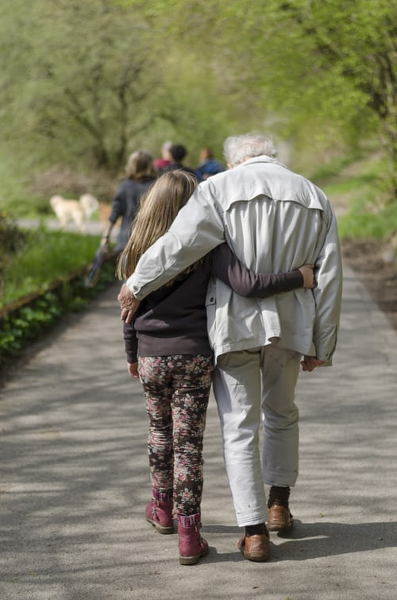
Thank you

